Slide 1

Azure VMware Solution
Run VMware natively on Azure and accelerate cloud migration

Slide 2
AVS Guided Pilot – What It Does
The Azure VMware Solution (AVS) Guided pilot, supported by the trial SKUs, does five main things;
Deploys the AVS private cloud.
Connects the AVS private cloud to Azure vNet (needed for communication to other Azure services).
Connects the AVS private cloud to the customer’s on-prem environment via their on-premises ExpressRoute. This is done via Global Reach.
Deploys VMware HCX Connector to the on-premises VMware cluster and connects that to the VMware HCX Cloud Manager within the AVS private cloud. This is needed to facilitate workload migrations and network extension from on-premises to Azure VMware Solution private cloud.
Provides prescriptive testing scenarios to validate the most common migration use cases.

Slide 3
AVS Guided Pilot – What It Does NOT Do
The Azure VMware Solution (AVS) guided pilot supports what is outlined in the prescriptive testing scenarios, any other activities would be considered out of scope for the trial pilot SKU.
Any other scenarios the customer would require can be architected in parallel to or after the pilot. Implementation of those configurations must be done after the 30-day pilot has ended OR the prescriptive testing scenarios have been satisfied.
Resources to support these more advanced designs would include the AVS GBB via a OneAsk and/or AVS migration partners.
More details for Azure VMware Solution, including field enablement, customer content, investments and program and partner information can be found on GearUp

Slide 4
Engagement
Completed by Automation Tool (total time roughly 5 hours) https://virtualworkloads.com/2022/01/fully-automated-from-0-to-migrating-workloads-to-avs-using-hcx/
Deploy AVS
Connect AVS to Azure vNet
Connect AVS to On-Prem
Deploy HCX to AVS
Deploy HCX On-Prem
Configure HCX On-Prem
Extend Networks (Optional)
Fixed Scope Testing
Production Readiness Design Discussions, Pilot Challenges, Migration Strategies, etc..
CSA and/or Partner
GBB If Needed
AVS Pilot (Fixed Scope) Migrate Workloads, Extend Networks, Basic Azure Service Integration, Create New Workloads, etc…etc…
Production Go-Live Planning

Slide 6
Engagement
First the Azure VMware Solution Private Cloud will be deployed.
Regardless of the final configuration, the private cloud must be deployed. This will be done to the customer’s defined region and subscription. The following are inputs which are required for the deployment.
Subscription ID
Region
Completed by Automation Tool (total time roughly 5 hours) https://virtualworkloads.com/2022/01/fully-automated-from-0-to-migrating-workloads-to-avs-using-hcx/
Deploy AVS
Connect AVS to Azure vNet
Connect AVS to On-Prem
Deploy HCX to AVS
Deploy HCX On-Prem
Configure HCX On-Prem
Extend Networks (Optional)
Fixed Scope Testing
Production Readiness Design Discussions, Pilot Challenges, Migration Strategies, etc..
CSA and/or Partner
GBB If Needed
AVS Pilot (Fixed Scope) Migrate Workloads, Extend Networks, Basic Azure Service Integration, Create New Workloads, etc…etc…
Production Go-Live Planning

Slide 7
Completed by Automation Tool (total time roughly 5 hours) https://virtualworkloads.com/2022/01/fully-automated-from-0-to-migrating-workloads-to-avs-using-hcx/
Deploy AVS
Connect AVS to Azure vNet
Connect AVS to On-Prem
Deploy HCX to AVS
Deploy HCX On-Prem
Configure HCX On-Prem
Extend Networks (Optional)
Regardless of the final configuration or use case the private cloud needs to be deployed.
The following needs to be completed prior to kicking off the deployment.
Apply and get customer approved for the AVS trial SKU program; details can be found here OR
Deploying the paid production SKU. Note; normal field funding mechanism can be used if desired, i.e., Azure credits. If the paid production SKU is being used quota must be enabled on the customer’s subscription; details can be found here.

Slide 8
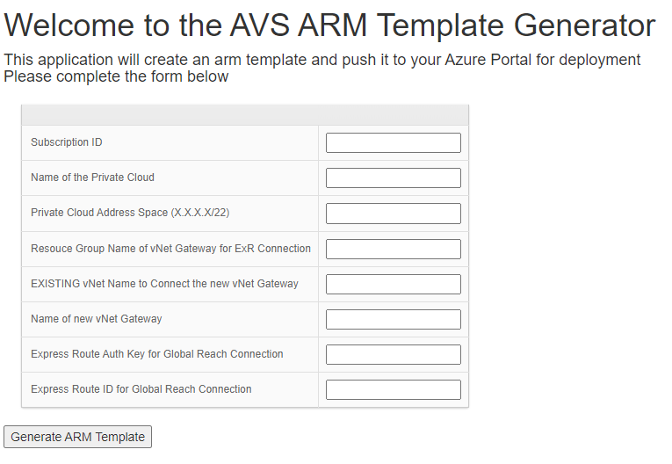
Completed by Automation Tool (total time roughly 5 hours) https://virtualworkloads.com/2022/01/fully-automated-from-0-to-migrating-workloads-to-avs-using-hcx/
Deploy AVS
Connect AVS to Azure vNet
Connect AVS to On-Prem
Deploy HCX to AVS
Deploy HCX On-Prem
Configure HCX On-Prem
Extend Networks (Optional)
To deploy the private cloud

